Slide 1
Stakeholder Engagement Guidance Identifying and Launching Your Community

Slide 2
Executive summary
Intended Audience
Domain stewards or leaders looking to bring together relevant stakeholders to create or foster communities of interest
Purpose
The purpose of this document is to provide domain stewards with guidance on how to develop and maintain an active community while utilizing official National Information Exchange Model (NIEM) communication artifacts.
Agenda
What is a Community of Interest?
Characteristics of a Strong Community of Interest
Building a Strong Community of interest
Stakeholder Engagement Guidance

Slide 3
What is a Community of Interest?
A community of interest is a group of people who share a common concern, a set of problems, or interest in a topic in order to fulfill both individual and group goals. A strong community can help you identify additional exchange partners to grow your data model and domain governance.
Communities are Domain Independent
Many Avenues Exist for Forming Communities
Intra-Domain vs. Inter-Domain Communities
COIs can be comprised of multiple domains or can be a subset of a domain
Organic
Stakeholders organically begin organizing themselves and sharing information around a specific concern, a set of problems, or topic
Directive
A directive from an authoritative body
Interest
A member of the NIEM community has an interest in, or identifies a need for, a community of interest
Coastal Defense COI
Marine Protection COI
Fisheries COI
Maritime Domain
Justice Domain
Human Services Domain
Anti-Human Trafficking Community of Interest
Immigration Domain
Intra-Domain
Inter-Domain
Spotlight on Organic Community Growth
The Health, Human Services, and Child, Youth, Family Services (CYFS) Domains are currently utilizing a shared collaboration site to exchange information and are meeting regularly to discuss relevant topics for effective harmonization.

Slide 4
Characteristics of a strong Community
A strong community includes an active set of stakeholders, with diversity of both representation and involvement, and a vested interest in furthering the mission of the community.
Description
Any entity that has a vested interest in furthering the given domain’s mission.
Stakeholders
Groups of people composed of practitioners and technical representatives (government and private sector) who, by virtue of their organizational affiliation, day-to-day operational responsibilities, or provision of services and programs, have a stake in the given domain’s NIEM information exchanges and who authoritatively represent their respective domains.
Active
Consistent information sharing amongst the community’s stakeholders; which can include, but are not limited to:
Program strategy Relevant news | Innovative solutions Program feedback | Business and technical requirements Constructive criticism
Diversity of Representation
Members are composed of representatives from a multitude of organizations at the local, state, federal, industry and tribal levels. The exact composition of organizations involved in the community will vary based on its mission area.
Diversity of Involvement
Involvement in the community, be it communication, collaboration, or any effort to further the activity of the community, is distributed amongst a diverse range of members.

Slide 5

Building a strong Community
Communities of interest are dynamic social structures that require “cultivation”, so that they can emerge and grow. The framework for domain stewards to reference when establishing and growing a strong community is outlined below.
Identify
Identify community target audience, mission, and goals
Grow
Design
Engage existing and new members in collaborative learning and knowledge sharing, group projects, and networking events to increase participation and contribution
Define the activities and roles that will support the community’s goals
Launch
Rollout the community by conducting outreach activities to the stakeholders defined in the “Identify” stage and executing on the activities and technologies outlined in the “Design” stage

Slide 6
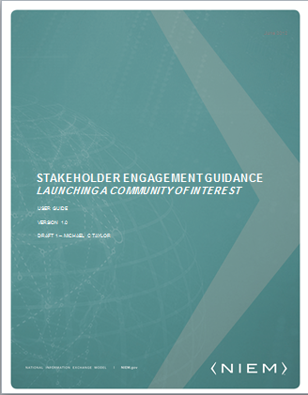
Stakeholder engagement guidance
The Stakeholder Engagement Guidance provides domain stewards with guidance on the recommended processes and actions to develop an active Community of Interest while highlighting NIEM resources available to assist them.
Content
Process
Suggests tactical steps for building a strong community at each stage of the four step iterative process
Provides examples of how NIEM users have successfully executed the process steps
Actions
Outlines actions for domain stewards to plan, design, roll-out, and grow their communities
Available Resources
Provides direct links to useful material on NIEM.gov such as:
NIEM value proposition statements
NIEM case studies and success stories
Assistance with collaboration zone set-up
Suggests ways in which the material can be used to launch a community of interest
More Information
Contact the NIEM PMO at information@niem.gov

